Slide 1

Lecture 4 Fourier Series of Continuous-time Signals
School of Computer Engineering and Science
Shanghai University
Instructor: Shengyu Duan, Weiwei Chen

Slide 2
Outline: Lecture 4: Fourier Series of Continuous-time Signals
Time/Frequency Domain
Response of LTI Systems to Exponential Signal
Fourier Series
Fourier Series Representation
Convergence Issue
Fourier Series Properties

Slide 3
Outline: Lecture 4: Fourier Series of Continuous-time Signals
Time/Frequency Domain
Response of LTI Systems to Exponential Signal
Fourier Series
Fourier Series Representation
Convergence Issue
Fourier Series Properties

Slide 4
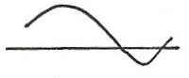
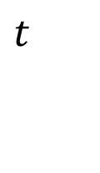
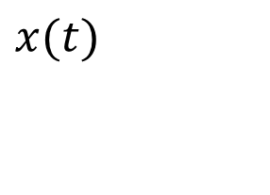
Time/Frequency Domain
Time domain signal
A signal is a function, in the mathematical sense, normally a function of time.
$$x(t)$$
$$t$$

Slide 5
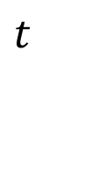
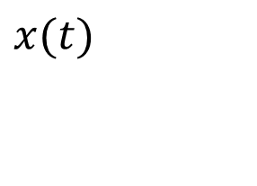
Time/Frequency Domain
Time domain signal
Time domain analysis examines the amplitude vs. time characteristics of a measuring signal.
Time domain is how people tend to think that things work, but in many situations, signals in time domain can be complicated.
$$x(t)$$
$$t$$

Slide 6
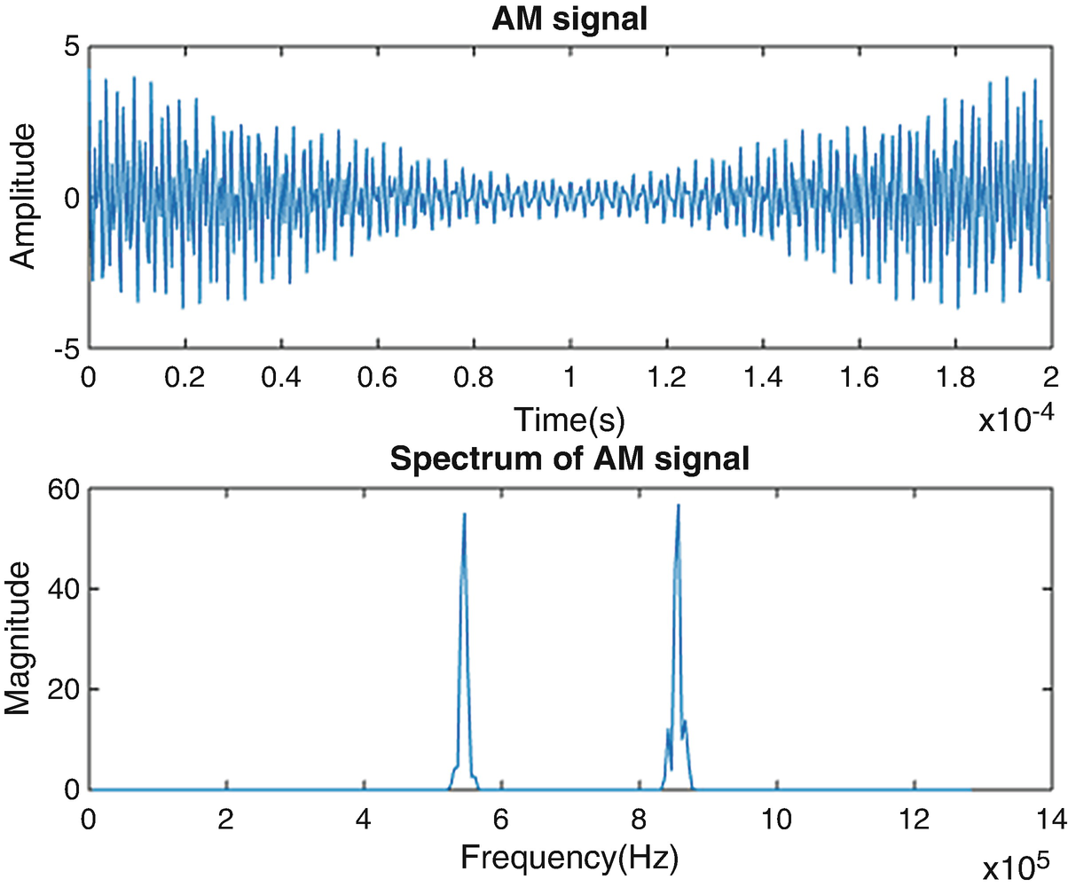

Time/Frequency Domain
Time domain signal
An audio signal in time domain
We can easily observe the loudness of a sound, but what else?
- Whose voice is this?
- How much is the noise?

Slide 7
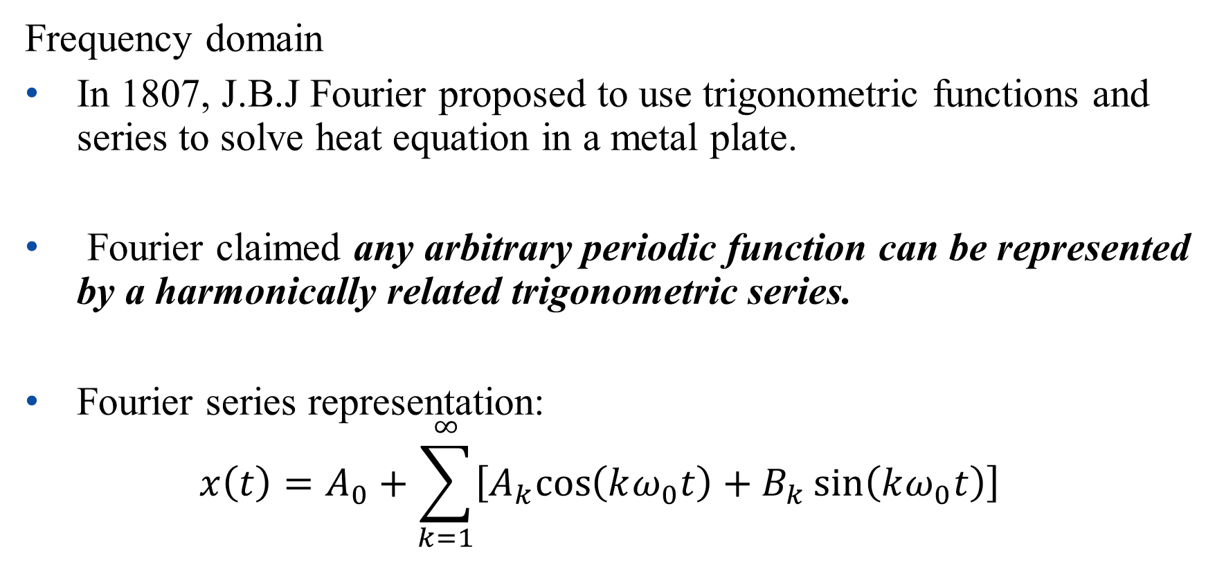
Time/Frequency Domain
Frequency domain
In 1807, J.B.J Fourier proposed to use trigonometric functions and series to solve heat equation in a metal plate.
Fourier claimed any arbitrary periodic function can be represented by a harmonically related trigonometric series.
Fourier series representation:
$$x\left(t\right)=A_{0}+\sum_{k=1}^{∞}{\left[A_{k}cos\left(kω_{0}t\right)+B_{k}\sin\left(kω_{0}t\right)\right]}$$

Slide 8
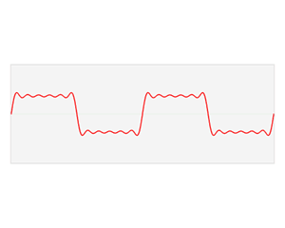
Time/Frequency Domain

Slide 9
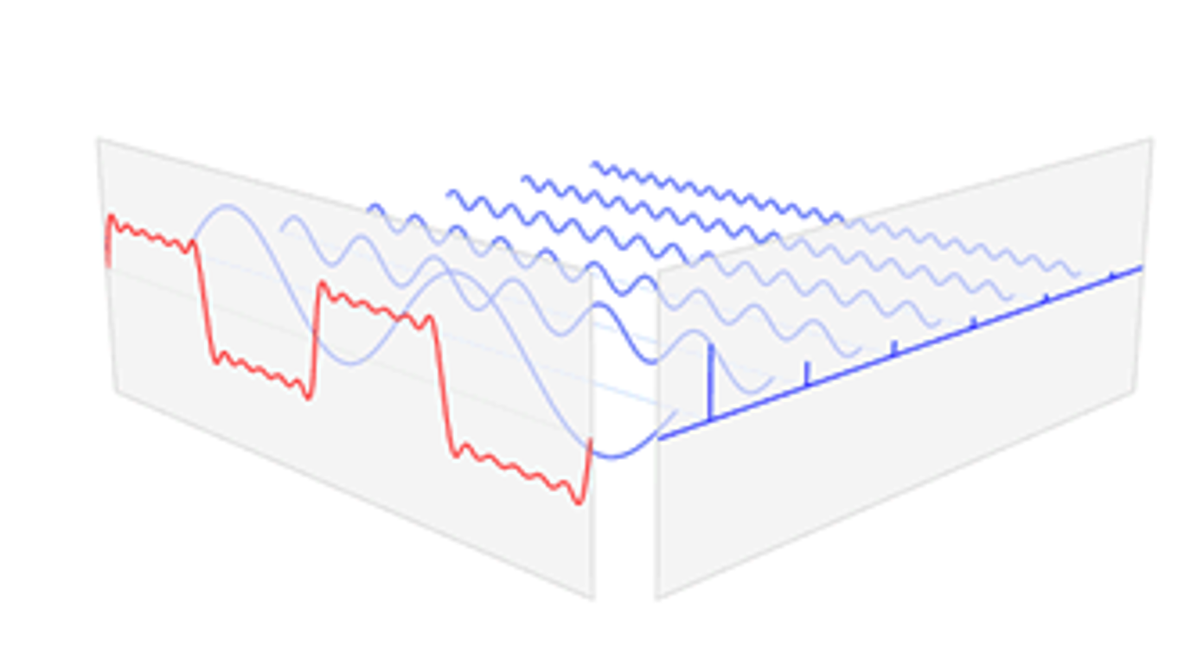
Time/Frequency Domain

Slide 10
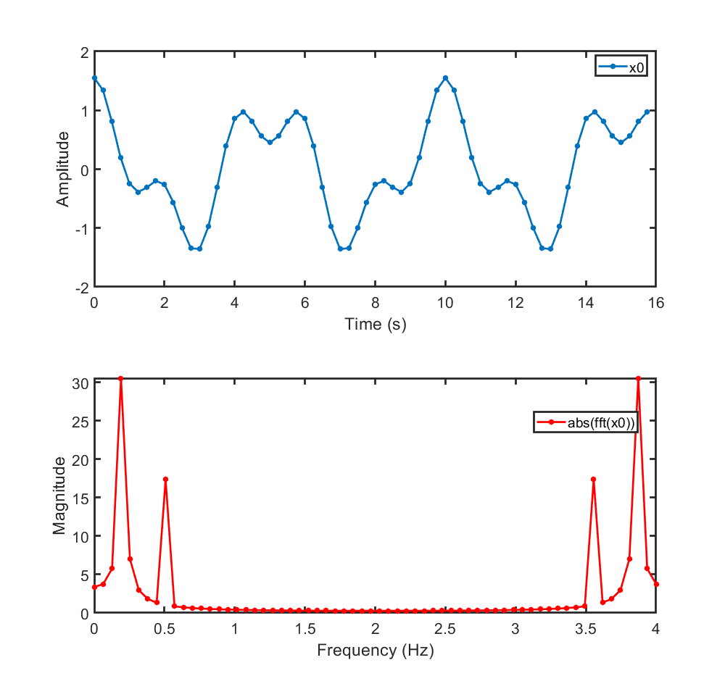
Time/Frequency Domain
Frequency domain
Frequency domain shows how much of the signal lies within each given frequency band over a range of frequencies.
Time domain signal
Frequency domain signal

Slide 11
Time/Frequency Domain
Why frequency domain is important
We can collect even more information in frequency domain, e.g.:
- Speaker recognition based on frequency-based coefficients
- Noise identification based on noise frequency characteristics
An audio signal in frequency domain

Slide 12
Time/Frequency Domain
Why frequency domain is important
Frequency domain is a different perspective on signal, which providing us more useful information.
Generally,
- Time domain shows how we tend to think that things work;
- Frequency domain can often provide many detailed performance specifications.

Slide 13
Outline: Lecture 4: Fourier Series of Continuous-time Signals
Time/Frequency Domain
Response of LTI Systems to Exponential Signal
Fourier Series
Fourier Series Representation
Convergence Issue
Fourier Series Properties

Slide 14
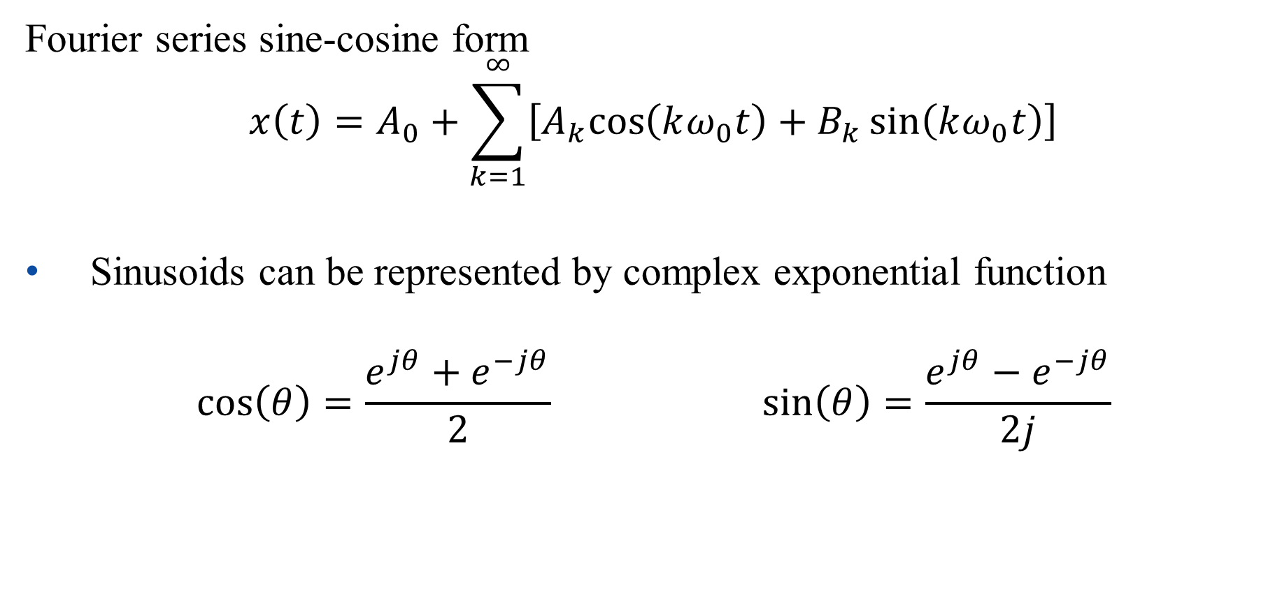
Response of LTI Systems to Exponential Signal
Fourier series sine-cosine form
$$x\left(t\right)=A_{0}+\sum_{k=1}^{∞}{\left[A_{k}cos\left(kω_{0}t\right)+B_{k}\sin\left(kω_{0}t\right)\right]}$$
Sinusoids can be represented by complex exponential function
$$\cos\left(θ\right)=\frac{e^{jθ}+e^{−jθ}}{2} \sin\left(θ\right)=\frac{e^{jθ}−e^{−jθ}}{2j}$$

Slide 15
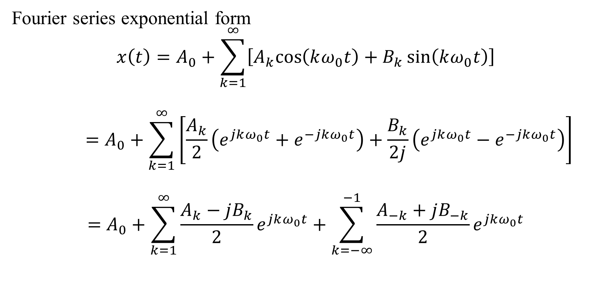
Response of LTI Systems to Exponential Signal
Fourier series exponential form
$$x\left(t\right)=A_{0}+\sum_{k=1}^{∞}{\left[A_{k}cos\left(kω_{0}t\right)+B_{k}\sin\left(kω_{0}t\right)\right]}$$
$$=A_{0}+\sum_{k=1}^{∞}{\left[\frac{A_{k}}{2}\left(e^{jkω_{0}t}+e^{−jkω_{0}t}\right)+\frac{B_{k}}{2j}\left(e^{jkω_{0}t}−e^{−jkω_{0}t}\right)\right]}$$
$$=A_{0}+\sum_{k=1}^{∞}{\frac{A_{k}−jB_{k}}{2}e^{jkω_{0}t}+\sum_{k=−∞}^{−1}{\frac{A_{−k}+jB_{−k}}{2}e^{jkω_{0}t}}}$$

Slide 16
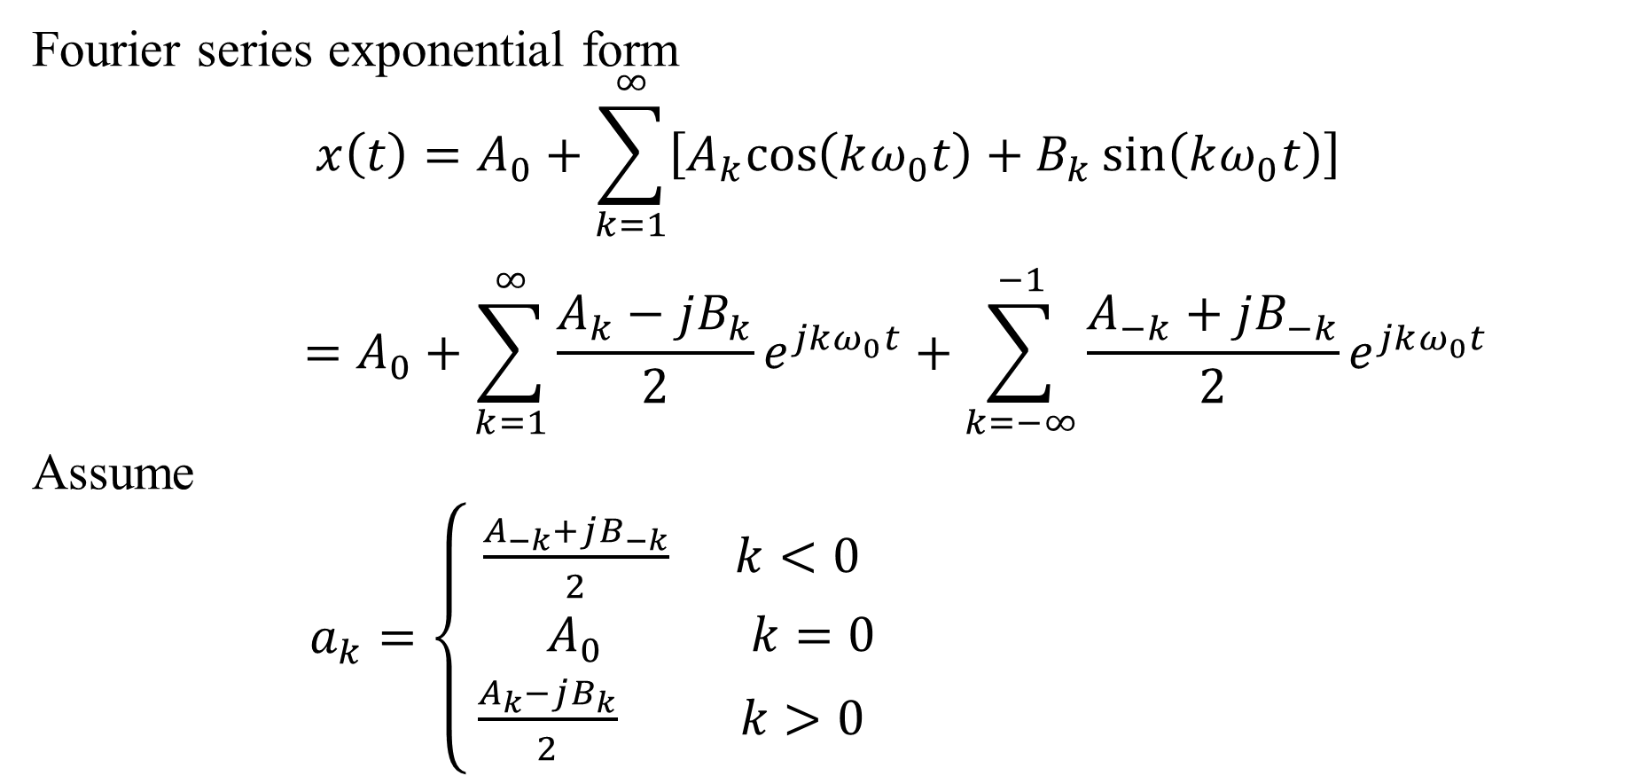
Response of LTI Systems to Exponential Signal
Fourier series exponential form
$$x\left(t\right)=A_{0}+\sum_{k=1}^{∞}{\left[A_{k}cos\left(kω_{0}t\right)+B_{k}\sin\left(kω_{0}t\right)\right]}$$
$$=A_{0}+\sum_{k=1}^{∞}{\frac{A_{k}−jB_{k}}{2}e^{jkω_{0}t}+\sum_{k=−∞}^{−1}{\frac{A_{−k}+jB_{−k}}{2}e^{jkω_{0}t}}}$$
Assume
$a_{k}=\left\{\begin{aligned}\frac{A_{−k}+jB_{−k}}{2} k<0 \\ { A}_{0} k=0 \\ \frac{A_{k}−jB_{k}}{2} k>0\end{aligned}\right.$

Slide 17
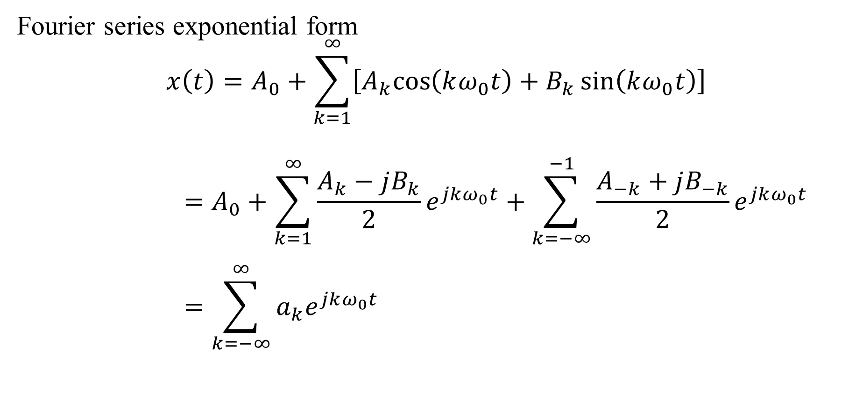
Response of LTI Systems to Exponential Signal
Fourier series exponential form
$$x\left(t\right)=A_{0}+\sum_{k=1}^{∞}{\left[A_{k}cos\left(kω_{0}t\right)+B_{k}\sin\left(kω_{0}t\right)\right]}$$
$$=A_{0}+\sum_{k=1}^{∞}{\frac{A_{k}−jB_{k}}{2}e^{jkω_{0}t}+\sum_{k=−∞}^{−1}{\frac{A_{−k}+jB_{−k}}{2}e^{jkω_{0}t}}}$$
$$=\sum_{k=−∞}^{∞}{a_{k}e^{jkω_{0}t}}$$

Slide 18
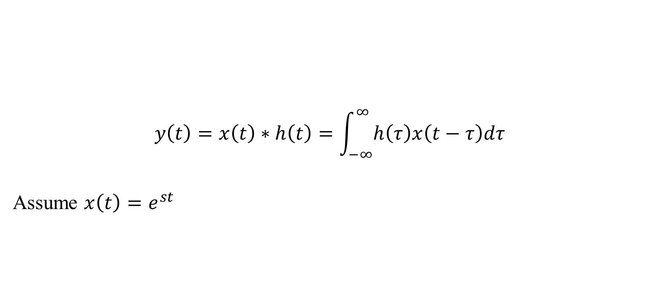
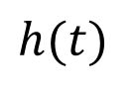
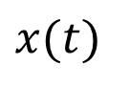
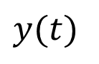
Response of LTI Systems to Exponential Signal
$$y\left(t\right)=x\left(t\right)∗h\left(t\right)=\int_{−∞}^{∞}{h\left(τ\right)x\left(t−τ\right)dτ}$$
Assume $x\left(t\right)=e^{st}$
$$h(t)$$
$$x(t)$$
$$y(t)$$
LTI

Slide 19
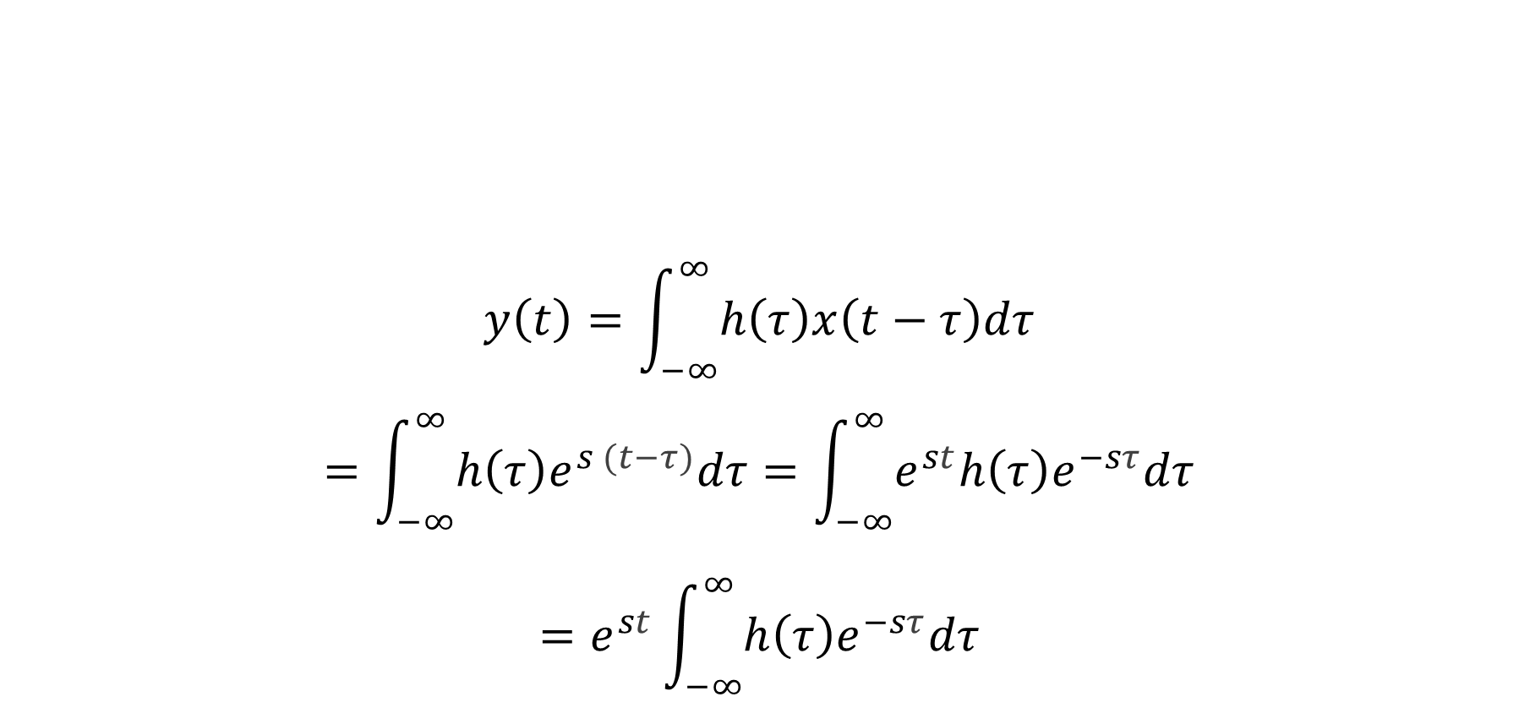
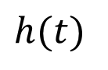
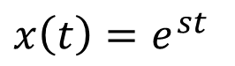
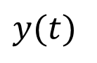
Response of LTI Systems to Exponential Signal
$$y\left(t\right)=\int_{−∞}^{∞}{h\left(τ\right)x\left(t−τ\right)dτ}$$
$$=\int_{−∞}^{∞}{h\left(τ\right)e^{s (t−τ)}dτ}=\int_{−∞}^{∞}{e^{st}h\left(τ\right)e^{−sτ}dτ}$$
$$=e^{st}\int_{−∞}^{∞}{h\left(τ\right)e^{−sτ}dτ}$$
$$h(t)$$
$$x\left(t\right)=e^{st}$$
$$y(t)$$
LTI

Slide 20
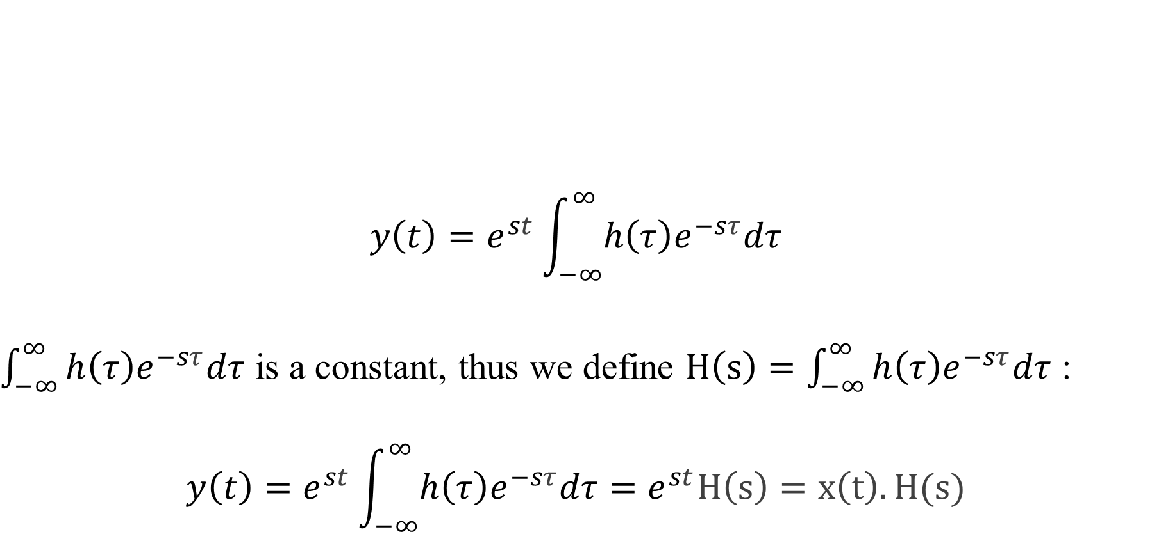
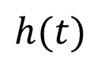
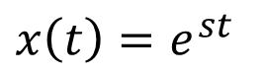
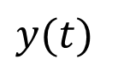
Response of LTI Systems to Exponential Signal
$$y\left(t\right)=e^{st}\int_{−∞}^{∞}{h\left(τ\right)e^{−sτ}dτ}$$
$\int_{−∞}^{∞}{h\left(τ\right)e^{−sτ}dτ}$ is a constant, thus we define $H\left(s\right)=\int_{−∞}^{∞}{h\left(τ\right)e^{−sτ}dτ}$ :
$$y\left(t\right)=e^{st}\int_{−∞}^{∞}{h\left(τ\right)e^{−sτ}dτ}=e^{st}H\left(s\right)=x\left(t\right).H(s)$$
$$h(t)$$
$$x\left(t\right)=e^{st}$$
$$y(t)$$
LTI

Slide 21
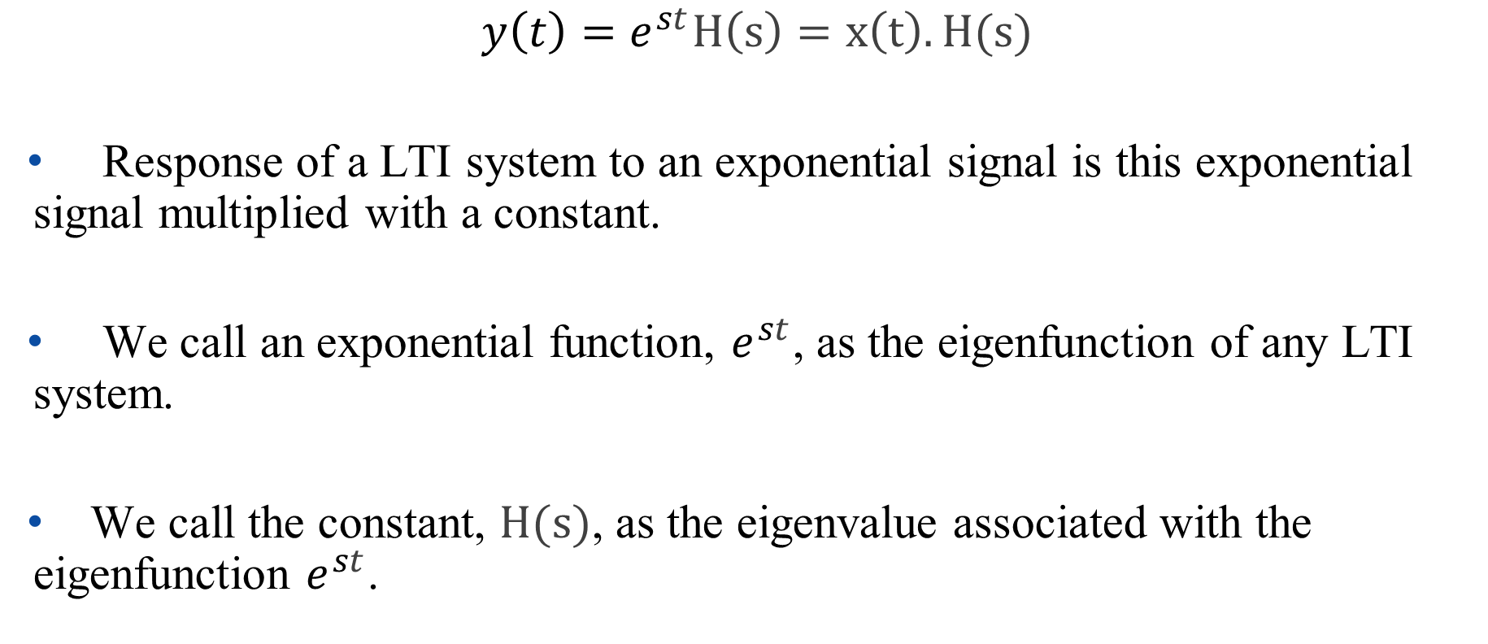
Response of LTI Systems to Exponential Signal
$$y\left(t\right)=e^{st}H\left(s\right)=x\left(t\right).H(s)$$
Response of a LTI system to an exponential signal is this exponential signal multiplied with a constant.
We call an exponential function, $e^{st}$, as the eigenfunction of any LTI system.
We call the constant, $H(s)$, as the eigenvalue associated with the eigenfunction $e^{st}$.

Slide 22
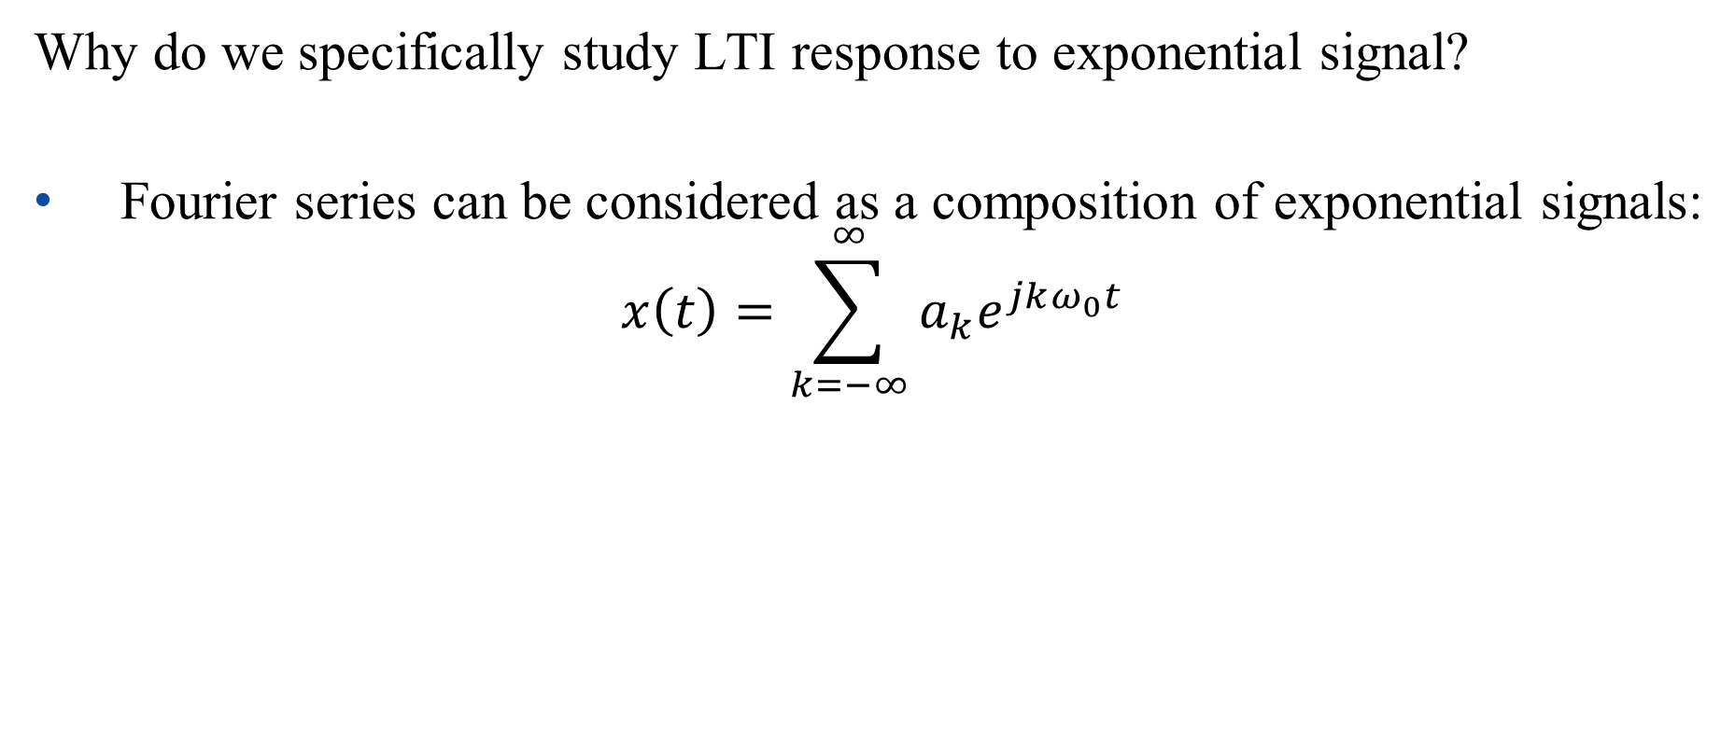
Response of LTI Systems to Exponential Signal
Why do we specifically study LTI response to exponential signal?
Fourier series can be considered as a composition of exponential signals:
$$x\left(t\right)=\sum_{k=−∞}^{∞}{a_{k}e^{jkω_{0}t}}$$

Slide 23
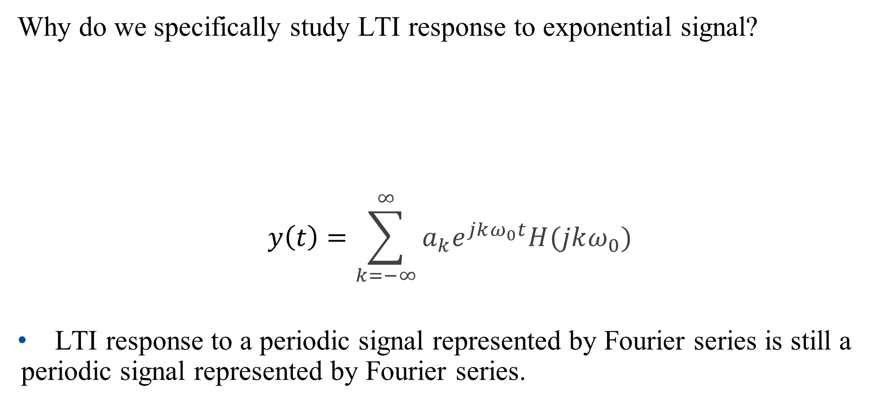
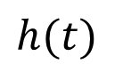
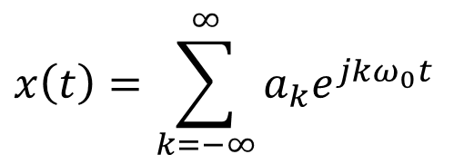
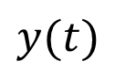
Response of LTI Systems to Exponential Signal
Why do we specifically study LTI response to exponential signal?
$$y\left(t\right)=\sum_{k=−∞}^{∞}{a_{k}e^{jkω_{0}t}H(jkω_{0})}$$
LTI response to a periodic signal represented by Fourier series is still a periodic signal represented by Fourier series.
$$x\left(t\right)=\sum_{k=−∞}^{∞}{a_{k}e^{jkω_{0}t}}$$
$$h(t)$$
$$y(t)$$
LTI

Slide 24
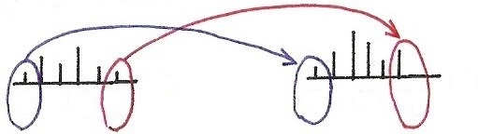
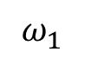
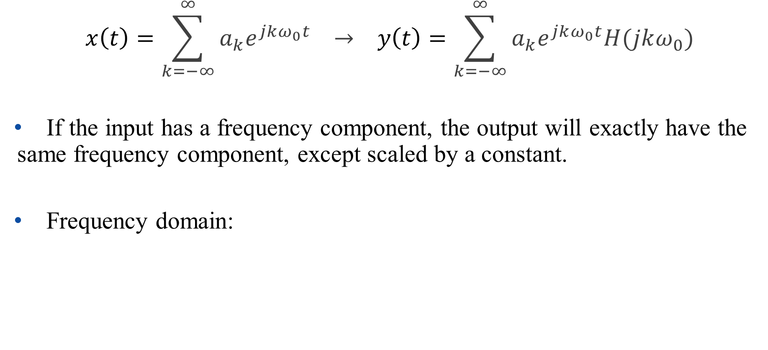
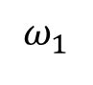
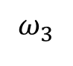
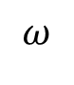
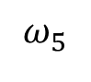
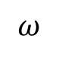
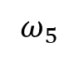
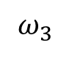
Response of LTI Systems to Exponential Signal
$$x\left(t\right)=\sum_{k=−∞}^{∞}{a_{k}e^{jkω_{0}t}} → y\left(t\right)=\sum_{k=−∞}^{∞}{a_{k}e^{jkω_{0}t}H(jkω_{0})}$$
If the input has a frequency component, the output will exactly have the same frequency component, except scaled by a constant.
Frequency domain:
$$ω$$
$$ω$$
$$ω_{1}$$
$$ω_{3}$$
$$ω_{5}$$
$$ω_{1}$$
$$ω_{3}$$
$$ω_{5}$$

Slide 25
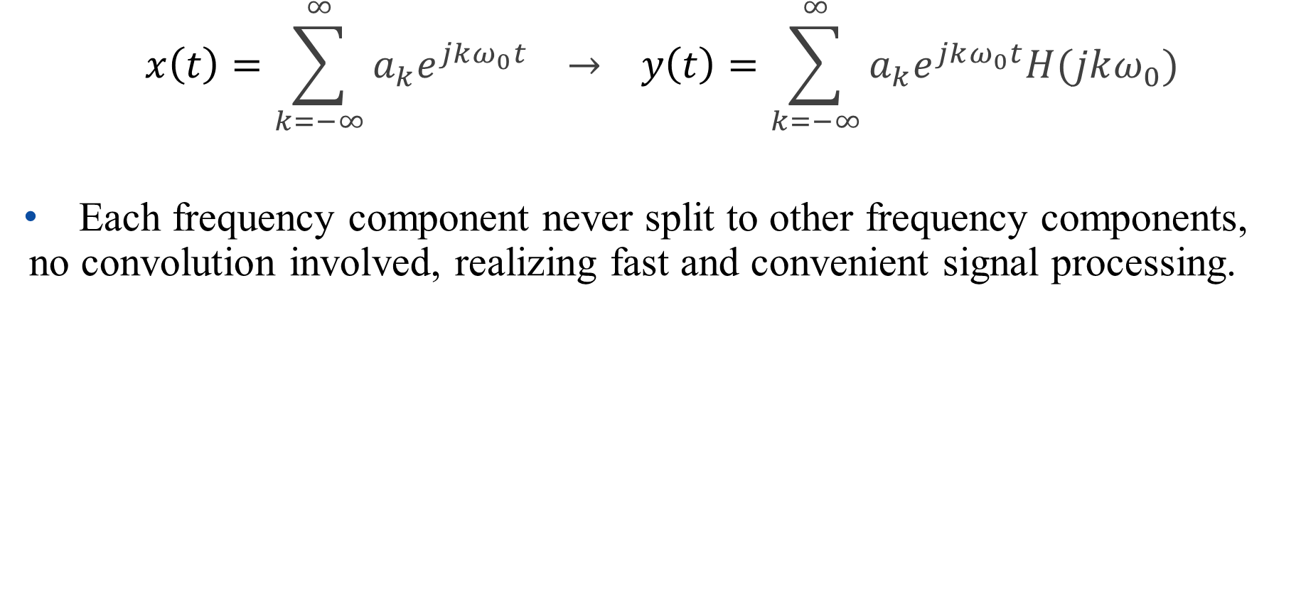
Response of LTI Systems to Exponential Signal
$$x\left(t\right)=\sum_{k=−∞}^{∞}{a_{k}e^{jkω_{0}t}} → y\left(t\right)=\sum_{k=−∞}^{∞}{a_{k}e^{jkω_{0}t}H(jkω_{0})}$$
Each frequency component never split to other frequency components, no convolution involved, realizing fast and convenient signal processing.

Slide 26
Outline: Lecture 4: Fourier Series of Continuous-time Signals
Time/Frequency Domain
Response of LTI Systems to Exponential Signal
Fourier Series
Fourier Series Representation
Convergence Issue
Fourier Series Properties

Slide 27
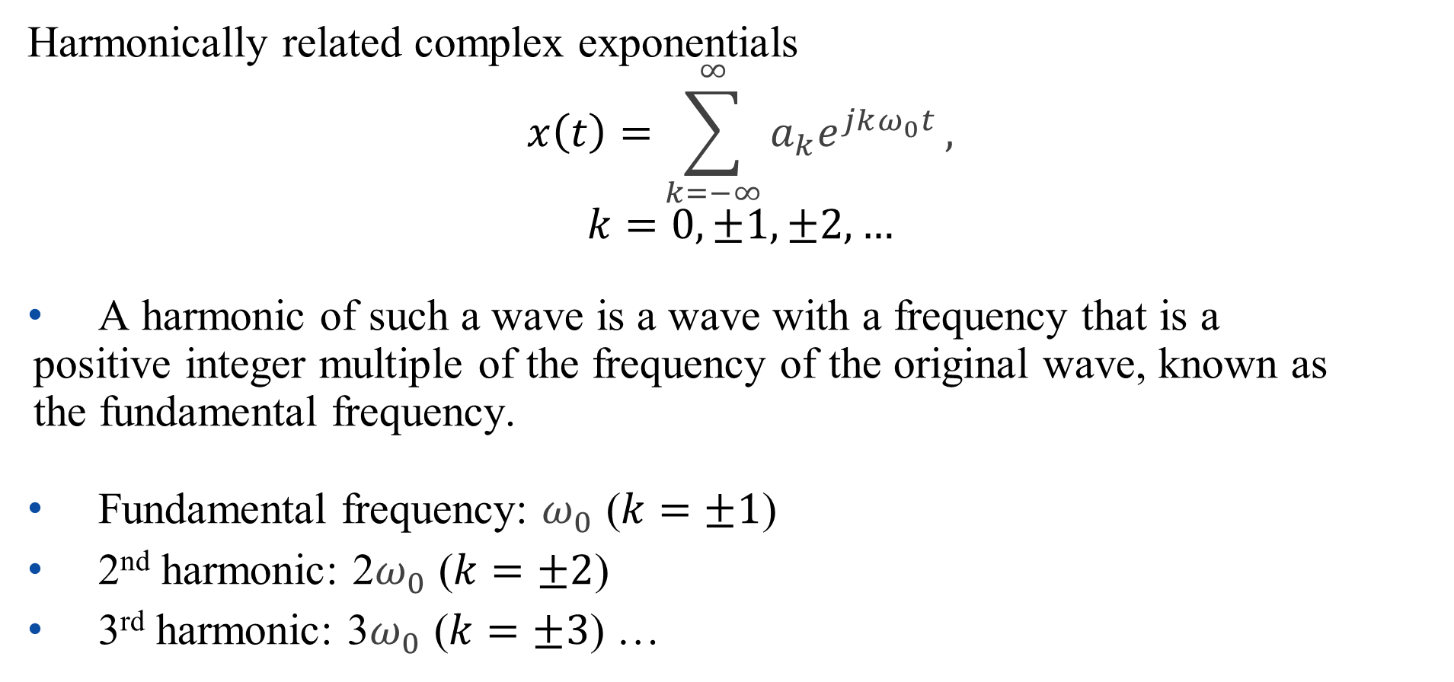
Fourier Series Representation
Harmonically related complex exponentials
$$x\left(t\right)=\sum_{k=−∞}^{∞}{a_{k}e^{jkω_{0}t}},$$
$$k=0,±1,±2,…$$
A harmonic of such a wave is a wave with a frequency that is a positive integer multiple of the frequency of the original wave, known as the fundamental frequency.
Fundamental frequency: $ω_{0}$ ($k=±1$)
2nd harmonic: 2$ω_{0}$ ($k=±2$)
3rd harmonic: 3$ω_{0}$ ($k=±3$) …

Slide 28
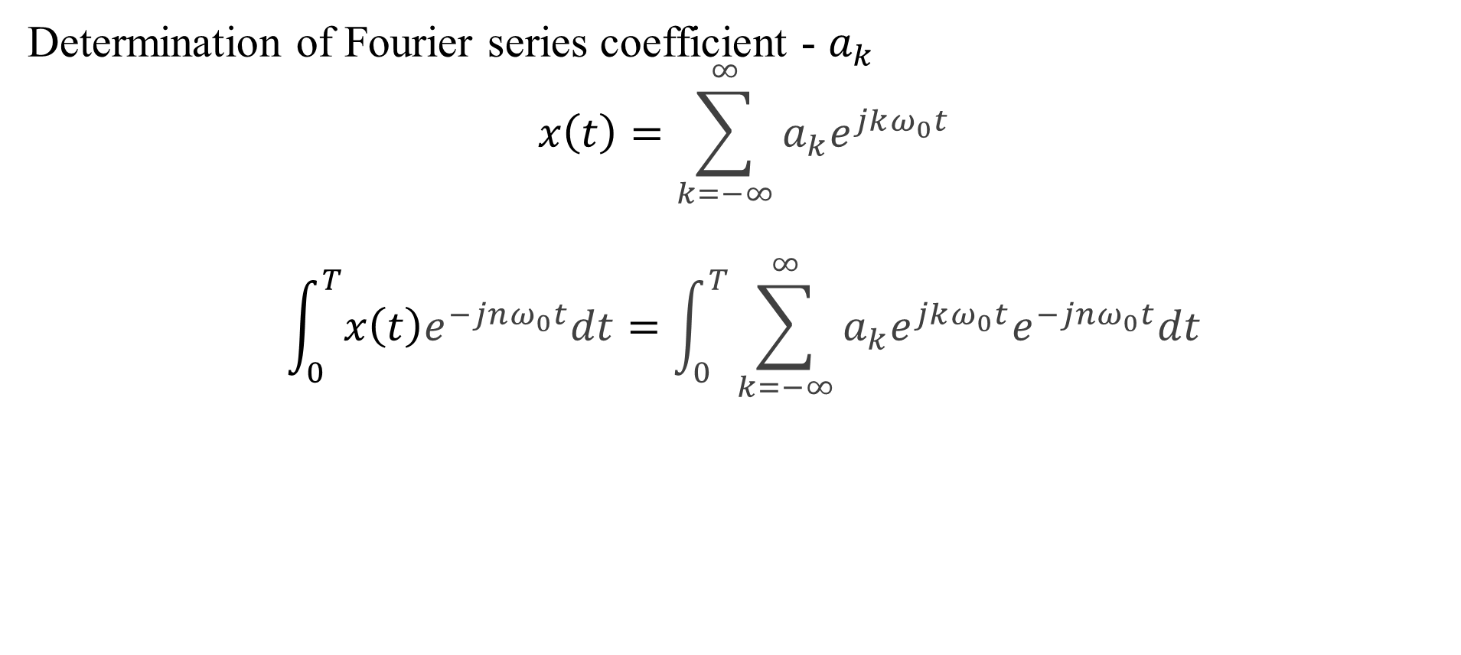
Fourier Series Representation
Determination of Fourier series coefficient - $a_{k}$
$$x\left(t\right)=\sum_{k=−∞}^{∞}{a_{k}e^{jkω_{0}t}}$$
$$\int_{0}^{T}{x\left(t\right)e^{−jnω_{0}t}dt}=\int_{0}^{T}{\sum_{k=−∞}^{∞}{a_{k}e^{jkω_{0}t}e^{−jnω_{0}t}dt}}$$

Slide 29
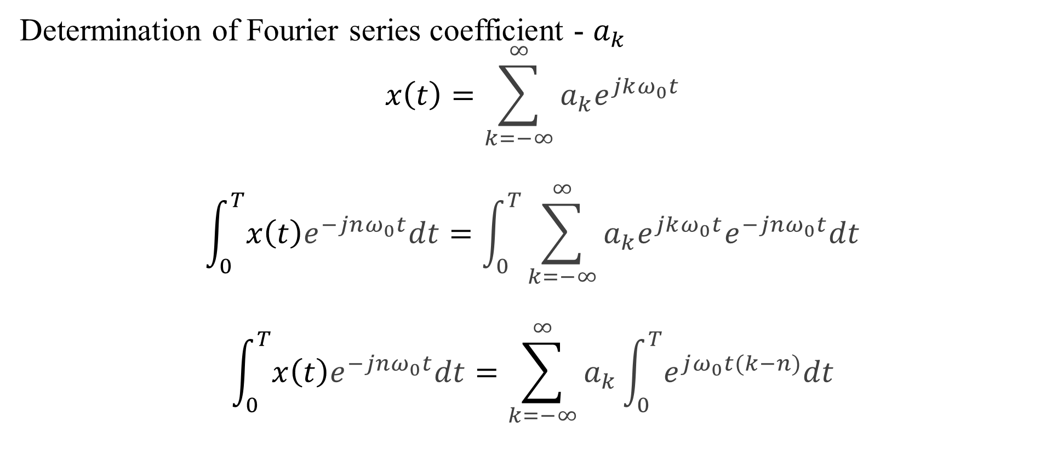
Fourier Series Representation
Determination of Fourier series coefficient - $a_{k}$
$$x\left(t\right)=\sum_{k=−∞}^{∞}{a_{k}e^{jkω_{0}t}}$$
$$\int_{0}^{T}{x\left(t\right)e^{−jnω_{0}t}dt}=\int_{0}^{T}{\sum_{k=−∞}^{∞}{a_{k}e^{jkω_{0}t}e^{−jnω_{0}t}dt}}$$
$$\int_{0}^{T}{x\left(t\right)e^{−jnω_{0}t}dt}=\sum_{k=−∞}^{∞}{a_{k}\int_{0}^{T}{e^{jω_{0}t(k−n)}dt}}$$

Slide 30
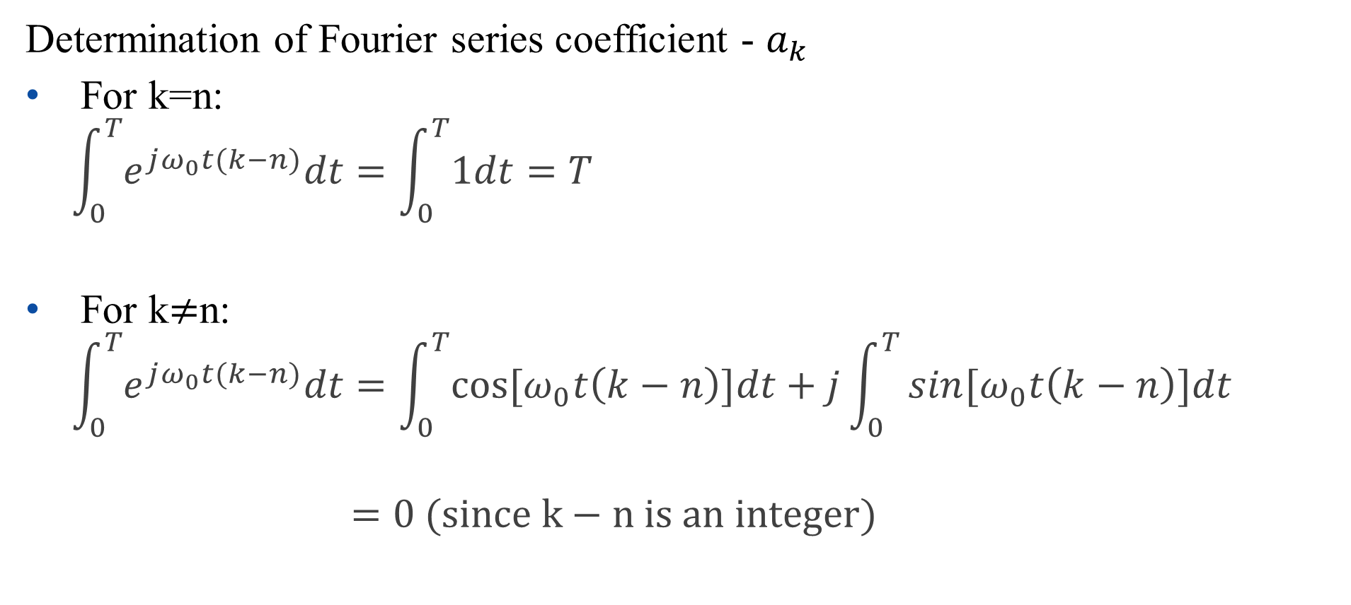
Fourier Series Representation
Determination of Fourier series coefficient - $a_{k}$
For k=n:
$$\int_{0}^{T}{e^{jω_{0}t(k−n)}dt}=\int_{0}^{T}{1dt}=T$$
For k$≠$n:
$$\int_{0}^{T}{e^{jω_{0}t(k−n)}dt}=\int_{0}^{T}{cos⁡[ω_{0}t\left(k−n\right)]dt}+j\int_{0}^{T}{⁡sin[ω_{0}t\left(k−n\right)]dt}$$
$$=0 (since k−n is an integer)$$

Slide 31
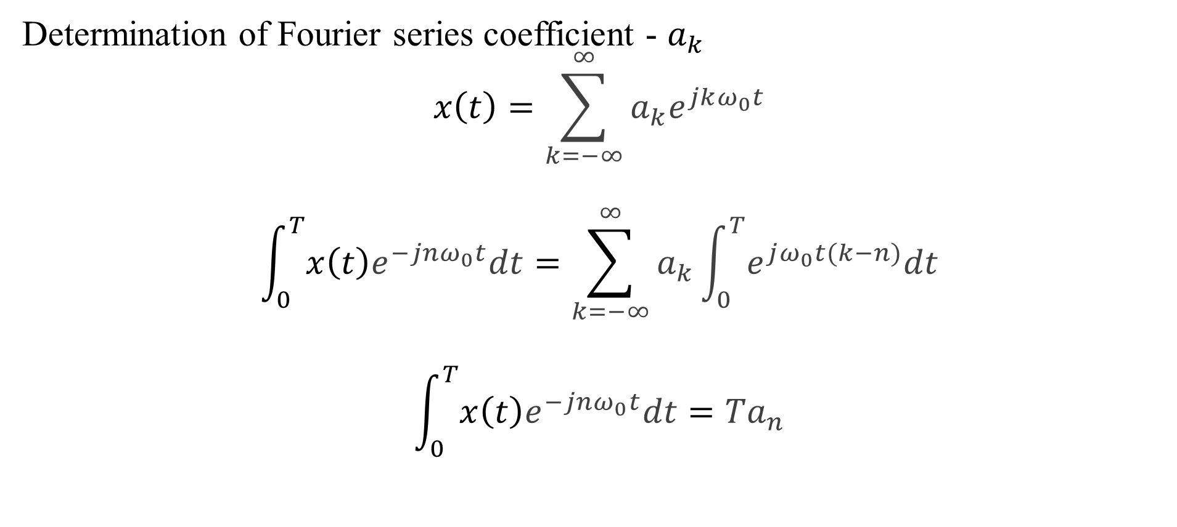
Fourier Series Representation
Determination of Fourier series coefficient - $a_{k}$
$$x\left(t\right)=\sum_{k=−∞}^{∞}{a_{k}e^{jkω_{0}t}}$$
$$\int_{0}^{T}{x\left(t\right)e^{−jnω_{0}t}dt}=\sum_{k=−∞}^{∞}{a_{k}\int_{0}^{T}{e^{jω_{0}t(k−n)}dt}}$$
$$\int_{0}^{T}{x\left(t\right)e^{−jnω_{0}t}dt}={Ta}_{n}$$

Slide 32
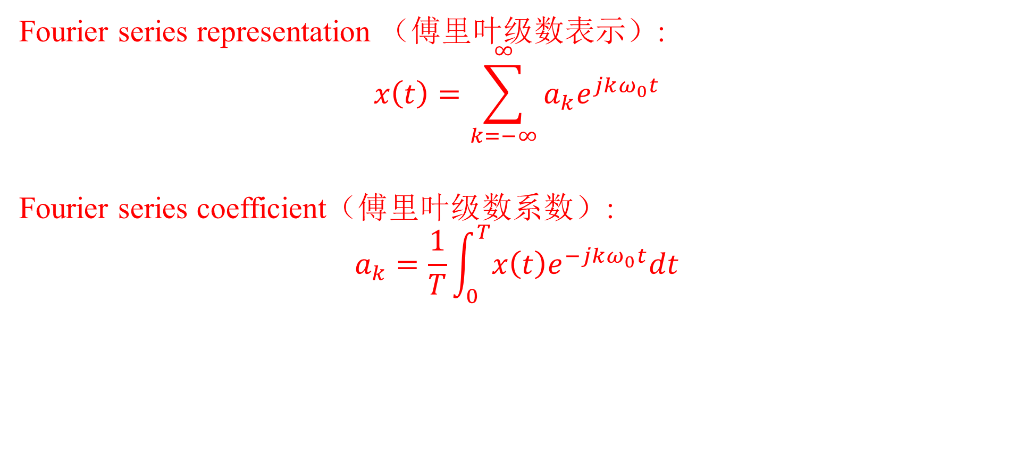
Fourier Series Representation
Fourier series representation （傅里叶级数表示）:
$$x\left(t\right)=\sum_{k=−∞}^{∞}{a_{k}e^{jkω_{0}t}}$$
Fourier series coefficient（傅里叶级数系数）:
$$a_{k}=\frac{1}{T}\int_{0}^{T}{x\left(t\right)e^{−jkω_{0}t}dt}$$

Slide 33
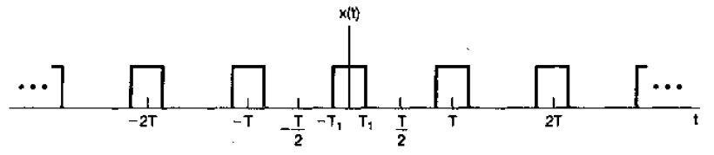

Fourier Series Representation
Example:
Find Fourier series coefficients for the following periodic signal.
$$x\left(t\right)=\left\{\begin{aligned}1, |t|<T_{1} \\ 0, { T}_{1}<\left|t\right|<T/2\end{aligned}\right.$$

Slide 34

Fourier Series Representation
$$x\left(t\right)=\left\{\begin{aligned}1, |t|<T_{1} \\ 0, { T}_{1}<\left|t\right|<T/2\end{aligned}\right.$$
$$a_{k}=\frac{1}{T}\int_{0}^{T}{x\left(t\right)e^{−jkω_{0}t}dt}=\frac{1}{T}\int_{{−T}_{1}}^{T_{1}}{e^{−jkω_{0}t}dt}$$
$$=\left\{\begin{aligned}\frac{e^{jkω_{0}T_{1}}−e^{−jkω_{0}T_{1}}}{jkω_{0}\frac{2π}{ω_{0}}}=\frac{sin⁡(kω_{0}T_{1}) }{kπ}, k≠0 \\ \frac{1}{T}\int_{{−T}_{1}}^{T_{1}}{dt}=\frac{2T_{1}}{T}, k=0\end{aligned}\right.$$
Solutions:

Slide 35



Fourier Series Representation
Assume $T_{1}=T/4：$
$$a_{k}=\left\{\begin{aligned}\frac{sin⁡(kω_{0}T_{1}) }{kπ}, k≠0 \\ \frac{1}{2}, k=0\end{aligned}\right.$$
Spectral:
$$a_{k}$$

Slide 36

Fourier Series Representation
Assume $T_{1}=T/4：$
$$a_{k}=\left\{\begin{aligned}\frac{sin⁡(kω_{0}T_{1}) }{kπ}, k≠0 \\ \frac{1}{2}, k=0\end{aligned}\right.$$
$$a_{k}$$
But is this correct?

Slide 37

Fourier Series Representation
Fourier series sine-cosine form
$$x\left(t\right)=A_{0}+\sum_{k=1}^{∞}{\left[A_{k}cos\left(kω_{0}t\right)+B_{k}\sin\left(kω_{0}t\right)\right]},$$
$$k=0,±1,±2,…$$
Fourier series amplitude-phase form
$$x\left(t\right)=a_{0}+2\sum_{k=1}^{∞}{A_{k}^{′}cos\left(kω_{0}t+θ_{k}\right)},$$
$$k=0,±1,±2,…$$

Slide 38

Fourier Series Representation
Amplitude-phase form derived from exponential form
$$x\left(t\right)=\sum_{k=−∞}^{∞}{a_{k}e^{jkω_{0}t}}$$
$$=a_{0}+\sum_{k=1}^{∞}{a_{k}e^{jkω_{0}t}}+\sum_{k=−∞}^{−1}{a_{k}e^{jkω_{0}t}}$$
$$=a_{0}+\sum_{k=1}^{∞}{(a_{k}e^{jkω_{0}t}+a_{−k}e^{−jkω_{0}t}})$$

Slide 39

Fourier Series Representation
Amplitude-phase form derived from exponential form
Remember in slide 16, we have assumed: $a_{k}=\left\{\begin{aligned}\frac{A_{−k}+jB_{−k}}{2} k<0 \\ { A}_{0} k=0 \\ \frac{A_{k}−jB_{k}}{2} k>0\end{aligned}\right.$, thus $a_{k}$ and $a_{−k}$ (for $k∈[1,∞]$) are a pair of complex conjugates.
${ e}^{jkω_{0}t}$ and $e^{−jkω_{0}t}$ (for $k∈[1,∞]$) are a pair of complex conjugates.
${a_{k}e}^{jkω_{0}t}$ and ${a_{−k}e}^{−jkω_{0}t}$ (for $k∈[1,∞]$) are also a pair of complex conjugates.

Slide 40

Fourier Series Representation
Amplitude-phase form derived from exponential form
Remember in slide 16, we have assumed: $a_{k}=\left\{\begin{aligned}\frac{A_{−k}+jB_{−k}}{2} k<0 \\ { A}_{0} k=0 \\ \frac{A_{k}−jB_{k}}{2} k>0\end{aligned}\right.$, thus $a_{k}$ and $a_{−k}$ (for $k∈[1,∞]$) are a pair of complex conjugates.
Note that the above hypothesis is true, only if $A_{k}$ and $B_{k}$ are real, and thus the signal is a real signal.

Slide 41
Fourier Series Representation
Amplitude-phase form derived from exponential form
Remember in slide 16, we have assumed: $a_{k}=\left\{\begin{aligned}\frac{A_{−k}+jB_{−k}}{2} k<0 \\ { A}_{0} k=0 \\ \frac{A_{k}−jB_{k}}{2} k>0\end{aligned}\right.$, thus $a_{k}$ and $a_{−k}$ (for $k∈[1,∞]$) are a pair of complex conjugates.
${ e}^{jkω_{0}t}$ and $e^{−jkω_{0}t}$ (for $k∈[1,∞]$) are a pair of complex conjugates.
${a_{k}e}^{jkω_{0}t}$ and ${a_{−k}e}^{−jkω_{0}t}$ (for $k∈[1,∞]$) are also a pair of complex conjugates.

Slide 42

Fourier Series Representation
Amplitude-phase form derived from exponential form
$$x\left(t\right)=\sum_{k=−∞}^{∞}{a_{k}e^{jkω_{0}t}}$$
$$=a_{0}+\sum_{k=1}^{∞}{(a_{k}e^{jkω_{0}t}+a_{−k}e^{−jkω_{0}t}})$$
$$=a_{0}+\sum_{k=1}^{∞}{2{ℝ\{a}_{k}e^{jkω_{0}t}\}}$$

Slide 43

Fourier Series Representation
Amplitude-phase form derived from exponential form
Use polar coordinate system to represent $a_{k}$ as: $a_{k}=A_{k}^{′}e^{{jθ}_{k}}$
$$x\left(t\right)=\sum_{k=−∞}^{∞}{a_{k}e^{jkω_{0}t}}$$
$$=a_{0}+\sum_{k=1}^{∞}{2{ℝ\{a}_{k}e^{jkω_{0}t}\}}=a_{0}+\sum_{k=1}^{∞}{2A_{k}^{′}ℝ\{e^{j(kω_{0}t+θ_{k})}\}}$$
$$=a_{0}+2\sum_{k=1}^{∞}{A_{k}^{′}cos⁡(kω_{0}t+θ_{k})}$$

Slide 44
Outline: Lecture 4: Fourier Series of Continuous-time Signals
Time/Frequency Domain
Response of LTI Systems to Exponential Signal
Fourier Series
Fourier Series Representation
Convergence Issue
Fourier Series Properties

Slide 45
Convergence Issue
Question:
In time domain, this signal is not continuous with discontinuity.
In frequency domain, this signal is represented by a trigonometric series, each of which is continuous.
How is the discontinuity represented?

Slide 46

Convergence Issue
Gibbs phenomenon（吉伯斯现象）

Slide 47
Convergence Issue
Gibbs phenomenon
The partial sum of the Fourier series has large oscillations near the jump, which might cause a fixed overshoot above the function itself.
As the number of terms rises, the error of the approximation is reduced in width and energy.
At the jump discontinuities, the limit will converge to the average of the values of the function on either side of the jump. (Dirichlet Theorem 狄利赫里定理)

Slide 48
Convergence Issue
A period signal can be represented by Fourier series, if it has finite energy:

Slide 49
Convergence Issue
Dirichlet’s condition（狄利赫里条件）
A signal can be represented by Fourier series expansion, if
(1) it is absolutely integrable,
(2) it has finite number of maxima & minima in a period
(3) it has finite number of discontinuities in a period

Slide 50


Convergence Issue
Dirichlet’s condition
A signal can be represented by Fourier series expansion, if
(1) it is absolutely integrable,
The signal below can not be represented by Fourier series expansion:
$$x\left(t\right)=\frac{1}{t}, 0<t≤1$$

Slide 51


Convergence Issue
Dirichlet’s condition
A signal can be represented by Fourier series expansion, if
(2) it has finite number of maxima & minima in a period
The signal below can not be represented by Fourier series expansion:
$$x\left(t\right)=sin⁡(\frac{2π}{t}), 0<t≤1$$

Slide 52


Convergence Issue
Dirichlet’s condition
A signal can be represented by Fourier series expansion, if
(3) it has finite number of discontinuities in a period
The signal below can not be represented by Fourier series expansion:
$$x\left(t\right)=\left\{\begin{aligned}1， 0≤t<4 \\ 1/2,4≤t<6 \\ {1/4,6≤t<7 \atop ⋮}\end{aligned}\right.$$

Slide 53
Outline: Lecture 4: Fourier Series of Continuous-time Signals
Time/Frequency Domain
Response of LTI Systems to Exponential Signal
Fourier Series
Fourier Series Representation
Convergence Issue
Fourier Series Properties

Slide 54

Fourier Series Properties
The following notation is used to indicate a signal, $x(t)$, can be represented by Fourier series with the coefficients, $a_{k}$.
$$x(t)\underset{↔}{FS}a_{k}$$

Slide 55

Fourier Series Properties
Linearity
Assume :
$x\left(t\right)\underset{↔}{FS}a_{k}, y(t)\underset{↔}{FS}b_{k}$,
Then:
$Ax\left(t\right)+By\left(t\right)\underset{↔}{FS}Aa_{k}+Bb_{k}$

Slide 56

Fourier Series Properties
Time shift
Assume :
$$x\left(t\right)\underset{↔}{FS}a_{k}, y\left(t\right)=x(t−t_{0})\underset{↔}{FS}b_{k}$$
Then:
$b_{k}=\frac{1}{T}\int_{0}^{T}{x\left(t−t_{0}\right)e^{−jkω_{0}t}dt}$
$$=\frac{1}{T}\int_{0}^{T}{x\left(t\right)e^{−jkω_{0}t}e^{−jkω_{0}t_{0}}dt}=a_{k}e^{−jkω_{0}t_{0}}$$
Time shift leads to unchanged amplitude and shifted phase.

Slide 57

Fourier Series Properties
Time reversal
Assume :
$$x\left(t\right)\underset{↔}{FS}a_{k}, y\left(t\right)=x(−t)\underset{↔}{FS}b_{k}$$
Then:
$b_{k}=\frac{1}{T}\int_{0}^{T}{x\left(−t\right)e^{jkω_{0}t}dt}$
$$=\frac{1}{T}\int_{0}^{T}{x\left(t\right)e^{j(−k)ω_{0}t}dt}=a_{−k}$$
$$x(−t)\underset{↔}{FS}a_{−k}$$

Slide 58

Fourier Series Properties
Time scaling
Assume :
$$x\left(t\right)\underset{↔}{FS}a_{k}$$
Then:
$$x(αt)=\sum_{k=−∞}^{∞}{a_{k}e^{jkω_{0}αt}}$$
$$x(αt)\underset{↔}{FS}a_{k}$$
Note that though Fourier series coefficients, $a_{k}$, is unchanged, Fourier series representation is different, because each harmonic component is different: for $x\left(t\right)$, the harmonic frequency is $kω_{0};$ for $x\left(αt\right)$, it is $kω_{0}α$.

Slide 59

Fourier Series Properties
Multiplication
Assume :
$$x\left(t\right)\underset{↔}{FS}a_{k}, y(t)\underset{↔}{FS}b_{k}\text{,}$$
Then:
$$d_{k}e^{j{kω}_{0}t}=\sum_{k_{1}}{\sum_{k_{2}}{a_{k_{1}}b_{k_{2}}}e^{j{(k_{1}+k_{2})ω}_{0}t}},k_{1}+k_{2}=k$$
Let $k_{1}=l,k_{2}=k−l:$
$$x\left(t\right)y\left(t\right)\underset{↔}{FS}d_{k}=\sum_{l=−∞}^{∞}{a_{l}b_{k−l}}=a_{k}∗b_{k}$$

Slide 60
Time/Frequency Domain

Slide 61

不同傅里叶级数表示形式的相互转换
解：首先回忆傅里叶级数表示的三种形式：
正余弦形式：
$$x\left(t\right)=A_{0}+\sum_{k=1}^{∞}{\left[A_{k}cos\left(kω_{0}t\right)+B_{k}\sin\left(kω_{0}t\right)\right]}$$
复指数形式：
$$x\left(t\right)=\sum_{k=−∞}^{∞}{a_{k}e^{jkω_{0}t}},a_{k}=\left\{\begin{aligned}\frac{A_{−k}+jB_{−k}}{2} k<0 \\ { A}_{0} k=0 \\ \frac{A_{k}−jB_{k}}{2} k>0\end{aligned}\right.$$
幅度-相位形式：
$$x\left(t\right)=a_{0}+2\sum_{k=1}^{∞}{A_{k}^{′}\cos\left(kω_{0}t+θ_{k}\right)},a_{k}=A_{k}^{′}e^{{jθ}_{k}}$$

Slide 62

Fourier Series Properties
Conjugation
Assume :
$$x\left(t\right)\underset{↔}{FS}a_{k}$$
Then:
$$x(t)=\sum_{k=−∞}^{∞}{a_{k}e^{jkω_{0}t}}$$
$$x^{∗}\left(t\right)=\sum_{k=−∞}^{∞}{a_{k}^{∗}{(e^{jkω_{0}t})}^{∗}=}\sum_{k=−∞}^{∞}{a_{k}^{∗}e^{−jkω_{0}t}=}\sum_{k=−∞}^{∞}{a_{−k}^{∗}e^{jkω_{0}t}}$$
$$x^{∗}(t)\underset{↔}{FS}a_{−k}^{∗}$$

Slide 63

Fourier Series Properties
Conjugation
Even/Odd property
$$x\left(t\right)\underset{↔}{FS}a_{k},x^{∗}(t)\underset{↔}{FS}a_{−k}^{∗}$$
If $x\left(t\right)$ is real ($x\left(t\right)=x^{∗}(t)$):
$$a_{k}=a_{−k}^{∗}$$

Slide 64

Fourier Series Properties
Conjugation
Even/Odd property
$$x\left(t\right)\underset{↔}{FS}a_{k},x^{∗}(t)\underset{↔}{FS}a_{−k}^{∗}$$
If $x\left(t\right)$ is real and even ($x\left(t\right)=x^{∗}\left(t\right),x\left(t\right)=x\left(−t\right)$):
$$a_{k}=a_{−k}^{∗},a_{k}=a_{−k}$$
$$⇒a_{−k}^{∗}=a_{−k}$$
$$⇒a_{k}^{∗}=a_{k}$$
$a_{k}$is real and even

Slide 65

Fourier Series Properties
Conjugation
Even/Odd property
$$x\left(t\right)\underset{↔}{FS}a_{k},x^{∗}(t)\underset{↔}{FS}a_{−k}^{∗}$$
If $x\left(t\right)$ is real and odd ($x\left(t\right)=x^{∗}\left(t\right),x\left(t\right)=−x\left(−t\right)$):
$$a_{k}=a_{−k}^{∗},a_{k}={−a}_{−k}$$
$$⇒a_{−k}^{∗}={−a}_{−k}$$
$$⇒a_{k}^{∗}={−a}_{k}$$
$a_{k}$is imaginary and odd

Slide 66

Fourier Series Properties
Parseval’s relation（帕斯瓦尔关系）
The average power of a function in a period is equal to the sum of the square (power) of its Fourier series coefficients.
$$\frac{1}{T}\int_{0}^{T}{{|x\left(t\right)|}^{2}dt}=\sum_{k=−∞}^{∞}{{|a_{k}|}^{2}}$$

Slide 67

Fourier Series Properties
Parseval’s relation
Proof:
$$\sum_{k=−∞}^{∞}{{|a_{k}|}^{2}}=\sum_{k=−∞}^{∞}{a_{k}}a_{k}^{∗}$$
$$=\sum_{k=−∞}^{∞}{a_{k}}[\frac{1}{T}\int_{0}^{T}{x^{∗}\left(t\right)e^{jkω_{0}t}dt}]=\frac{1}{T} \int_{0}^{T}{x^{∗}\left(t\right)[\sum_{k=−∞}^{∞}{a_{k}e^{jkω_{0}t}]dt}}$$
$$=\frac{1}{T} \int_{0}^{T}{x^{∗}\left(t\right)x\left(t\right)dt}=\frac{1}{T} \int_{0}^{T}{{|x\left(t\right)|}^{2}}dt$$

Slide 68
Thank you for your listening!

